Slide 1


Slide 2


Download the slides
http://theleanprogrammer.com/aam/5

Slide 3


What are we going to learn today?
React Router
React Portals

Slide 4

Let’s see a live demo
http://madhavbahl.tech/portfolio/

Slide 5
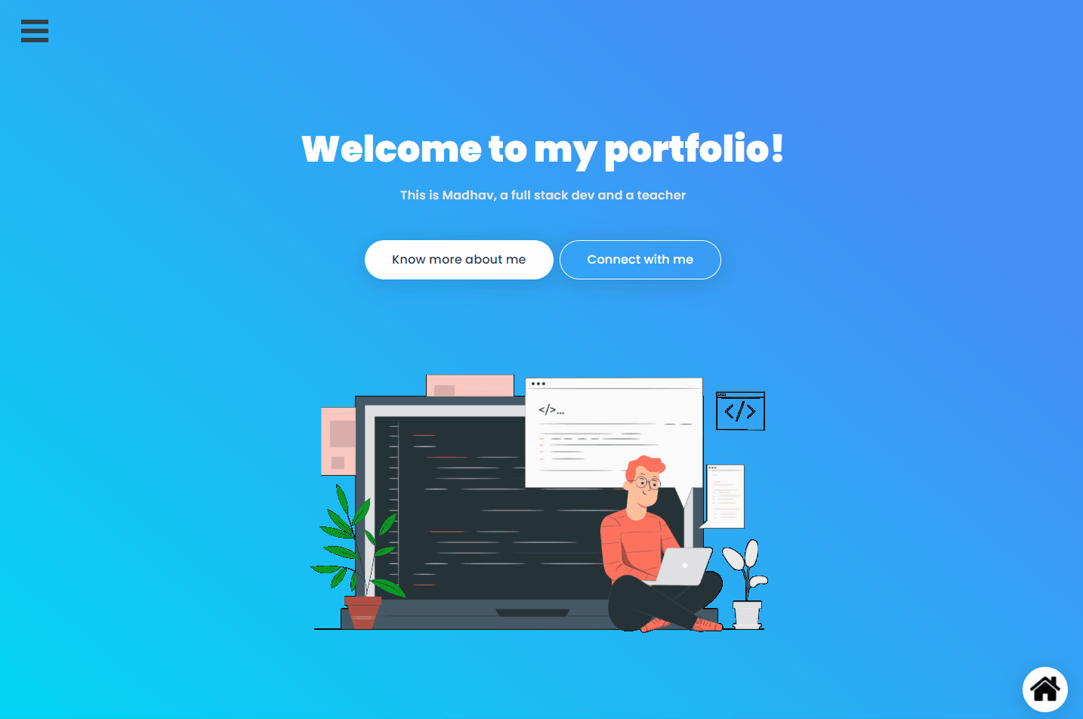

Slide 6
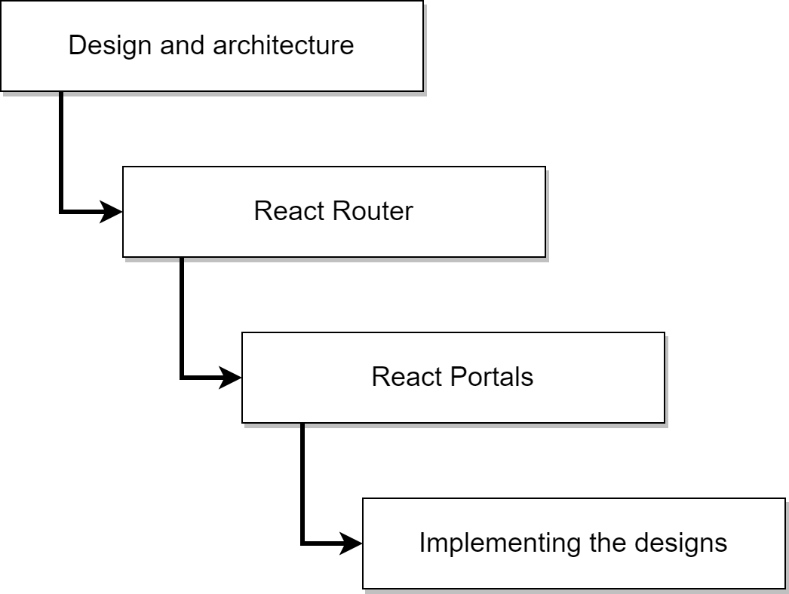
Our flow for today

Slide 7
Section 1: understanding the wireframes and architecture

Slide 8
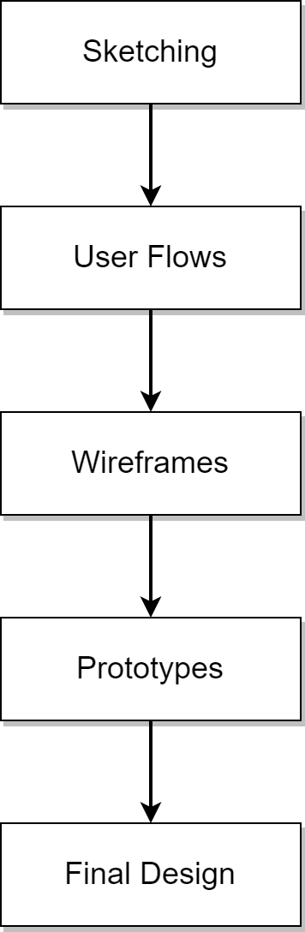
Various phases in design

Slide 9
List of pages
Home page
About page
Projects page
Skills page
Contact me page

Slide 10
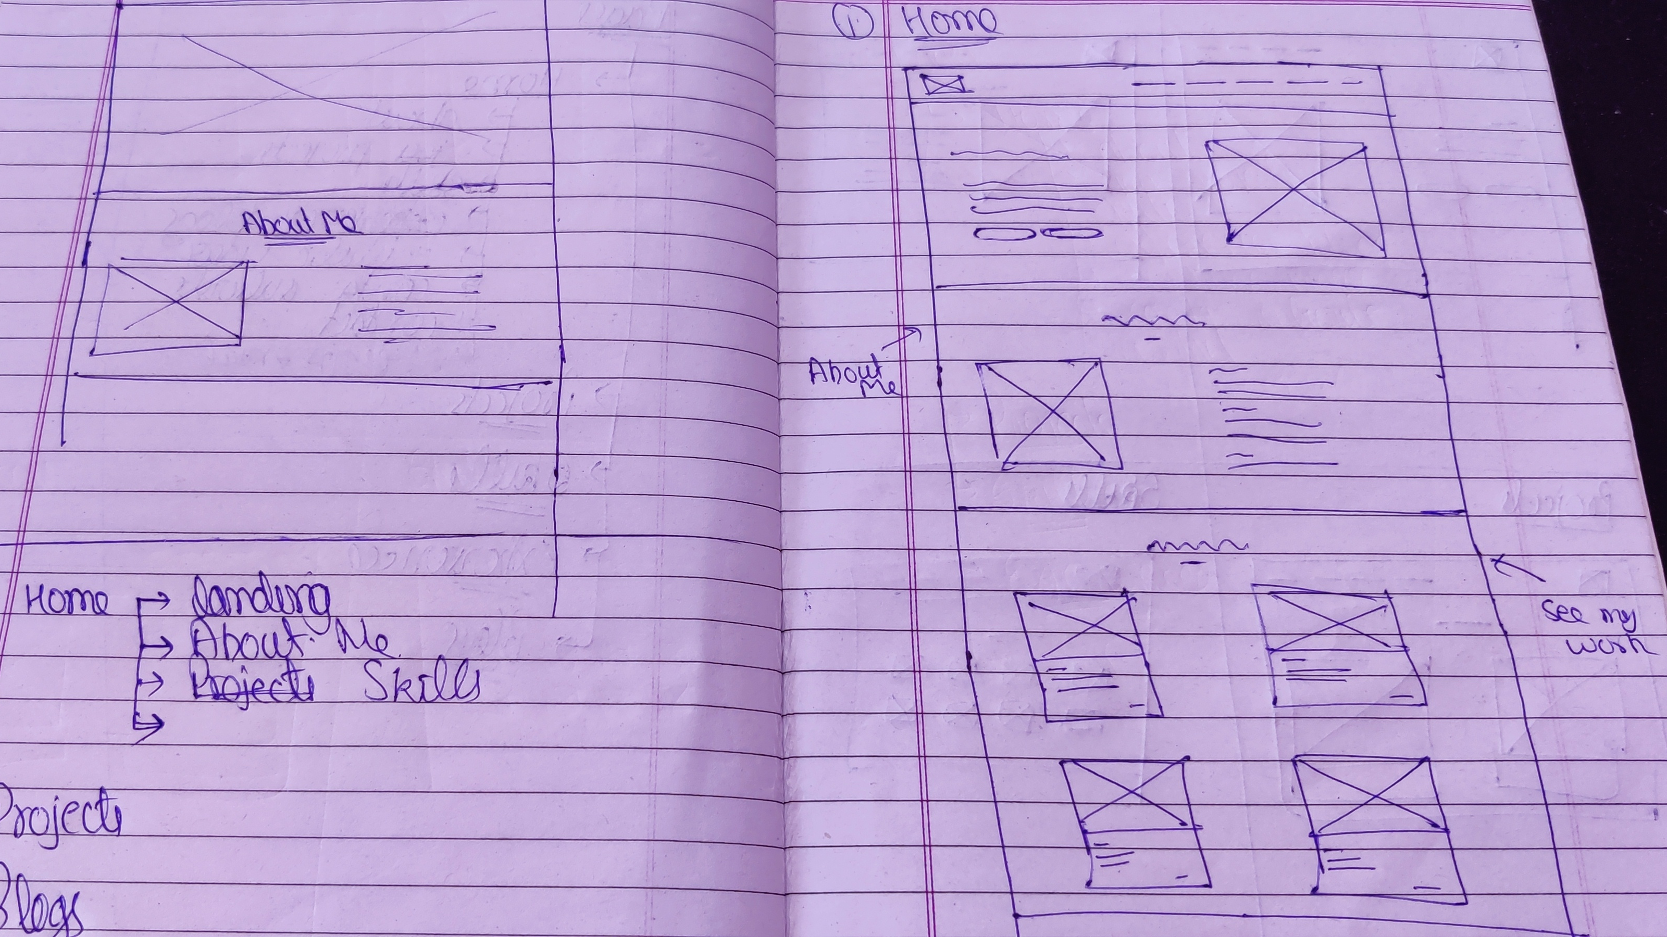
Sketch

Slide 11
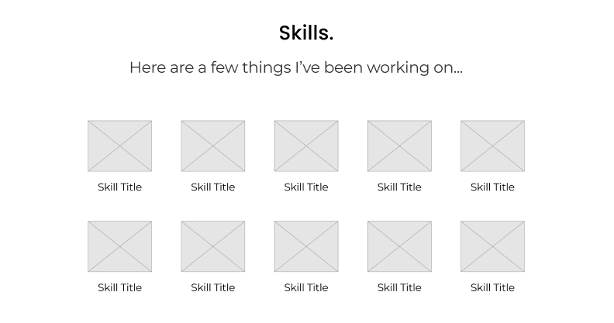
Understanding the wireframes

Slide 12
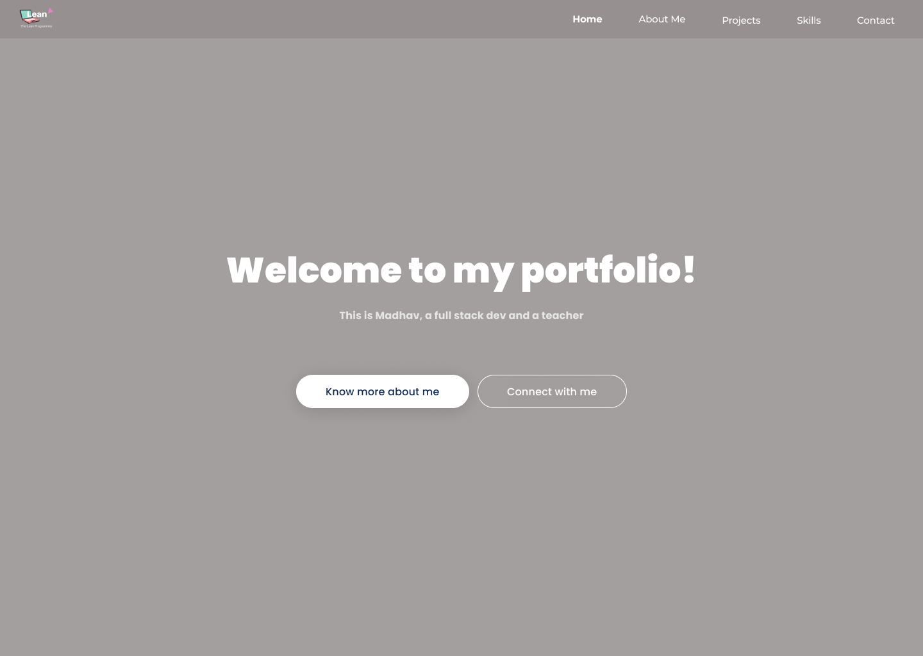
home

Slide 13
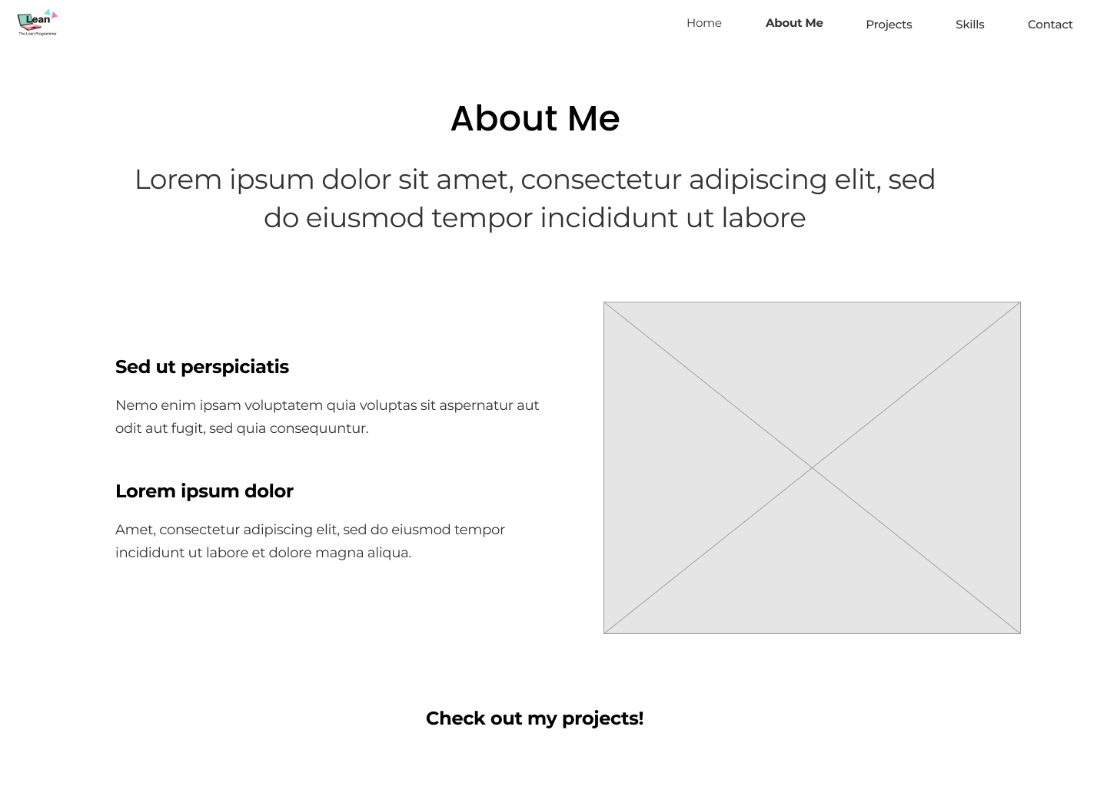
about

Slide 14
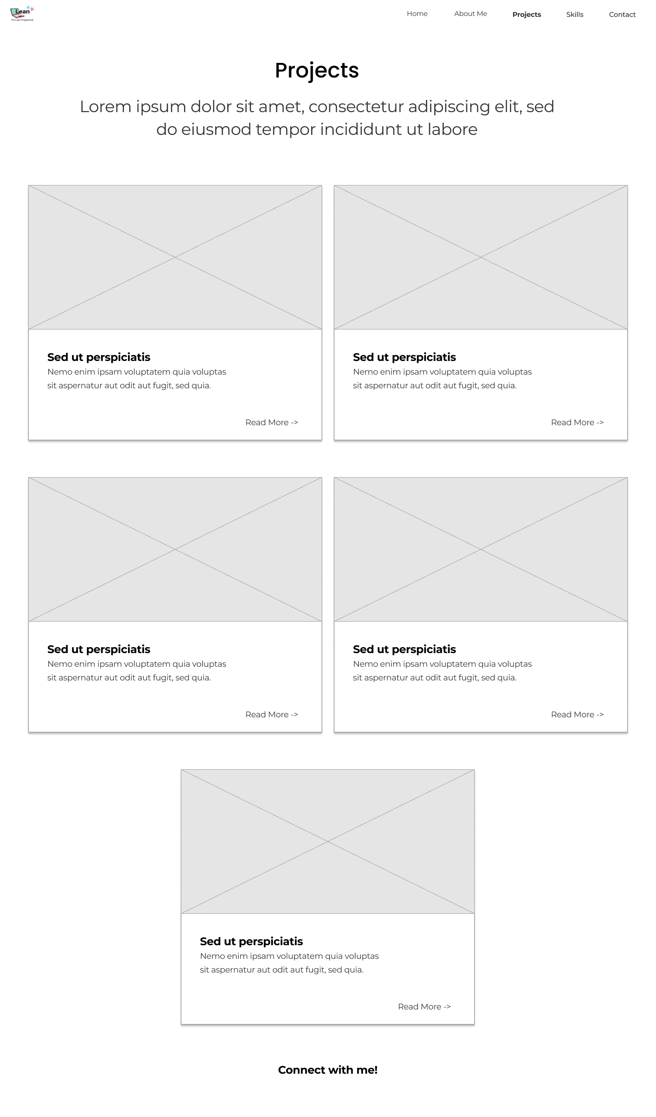
projects

Slide 15
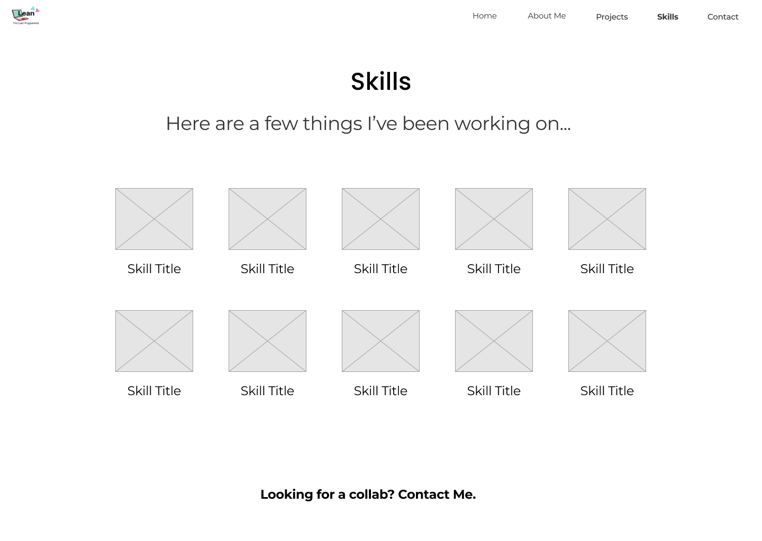
skills

Slide 16
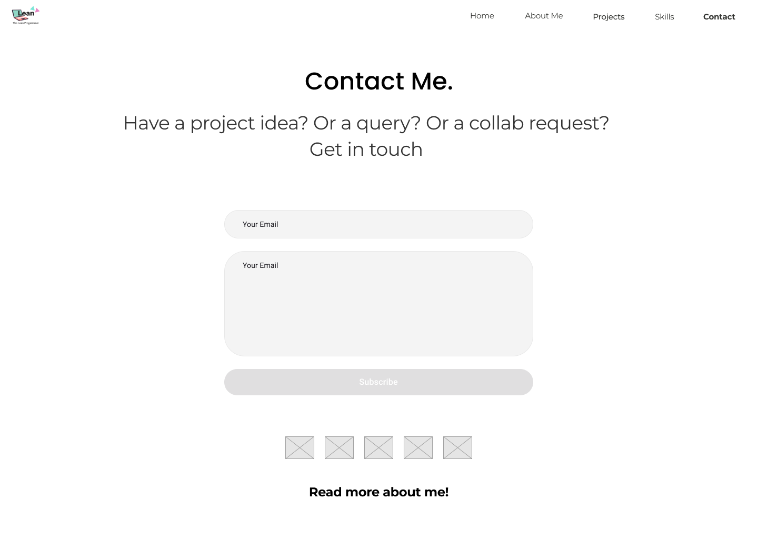
contact

Slide 17
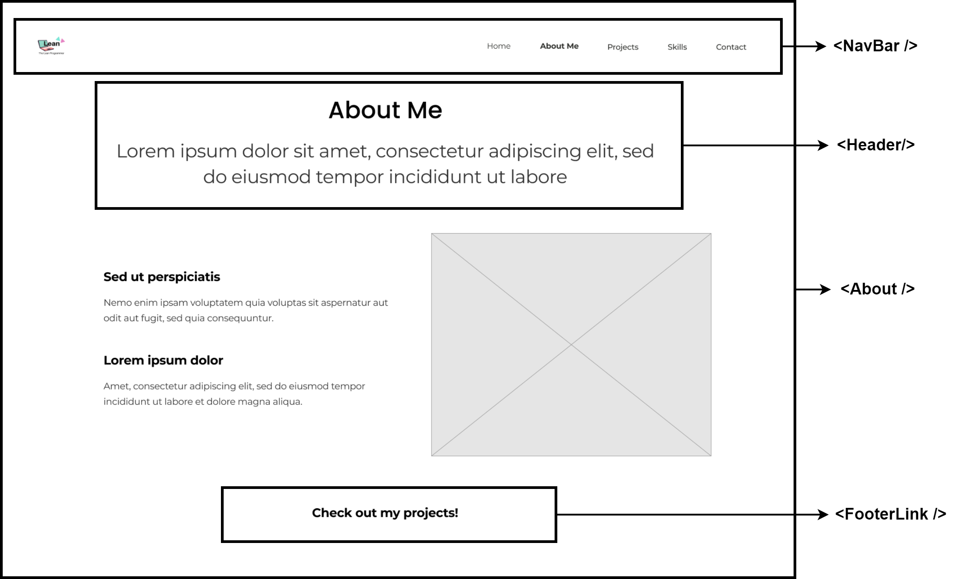
Let’s finalize the react components!

